Slide 1



Brikshya
Team Spark

Slide 2
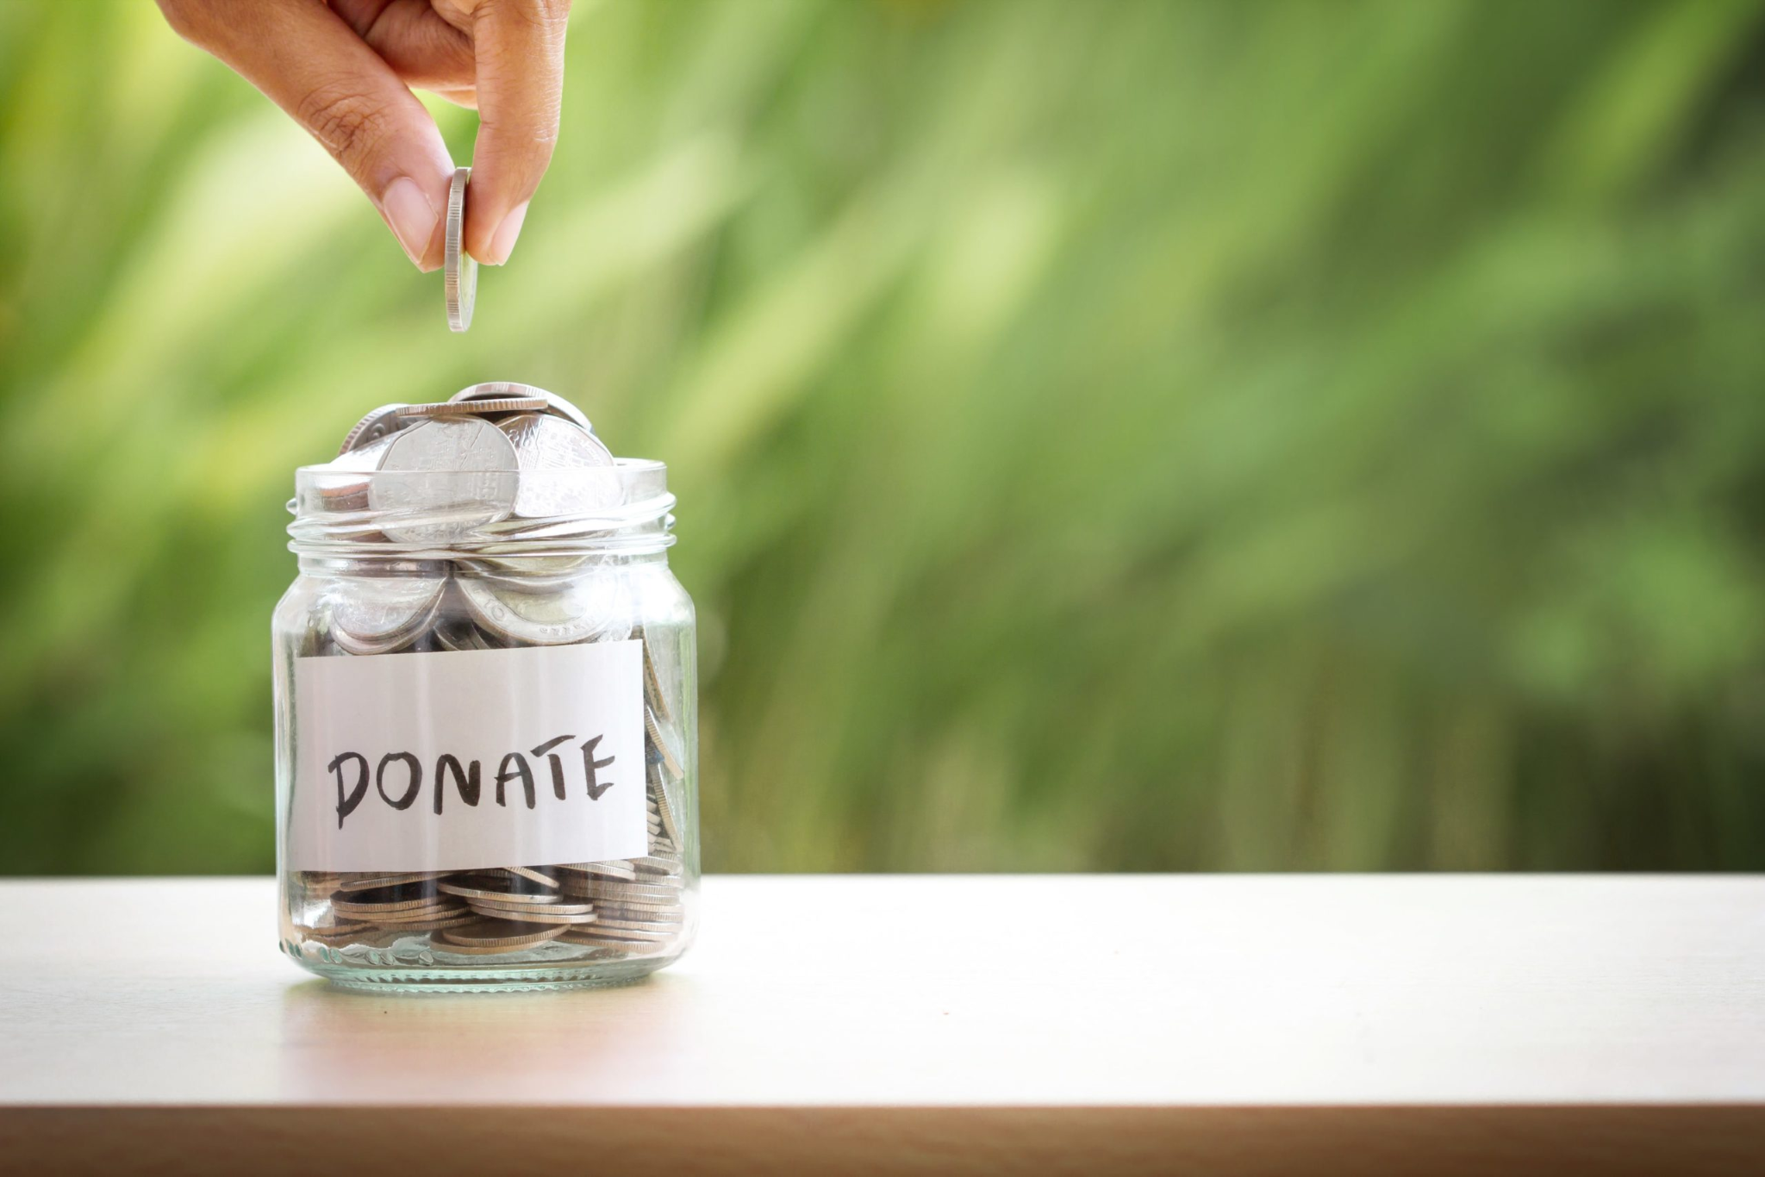
Let me
Share
you our
story

Slide 3
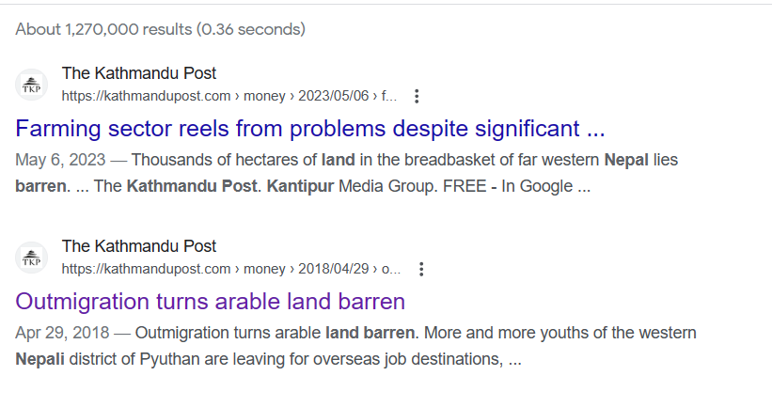

Problems
Lack of transparency and accountability in tree planting projects.
Barren lands are leading to soil infertility damaging soil.
Carbon emission increasing day by day.
Lack of notifying the donors the progress made so far by their planted trees.
Deforestation increasing day by day.

Slide 4




Solutions
Tracking System to better track your tree.
Enabling metric calculations to plant better quality Trees according to the environment.
Planting More Trees.

Slide 5
Brikshya
“A Platform to track your tree planted, offering complete transparency

Slide 6




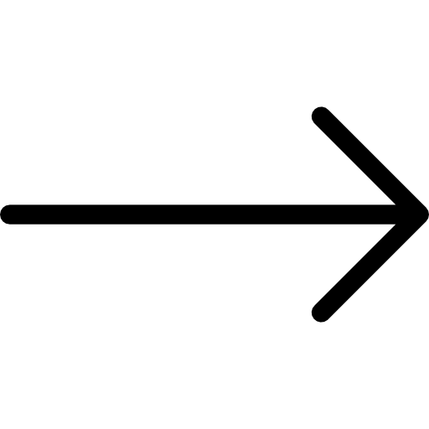














How it works?
Paid via Money Wallets
How many Trees?
Pay 1 Tree = 99 NPR
A Person wants to plant a tree
Capturing Photos
Per Person Trees
Brikshya Fund
Plantation Program Organized
Sensor Fit at every 30Sq.Ft
notify
alert
Plantation Program Potentiality Research
A Person Regularly Monitors the Planted Trees
Collaborate with Community Organization
Large Fund Gets Collected

Slide 7
How we are Environment Friendly?
No any Hamper to Environment
More Plantation leading to balance in ecosystem
Preserving biodiversity
Purification of Air
Positive impacts on Climate Change

Slide 8
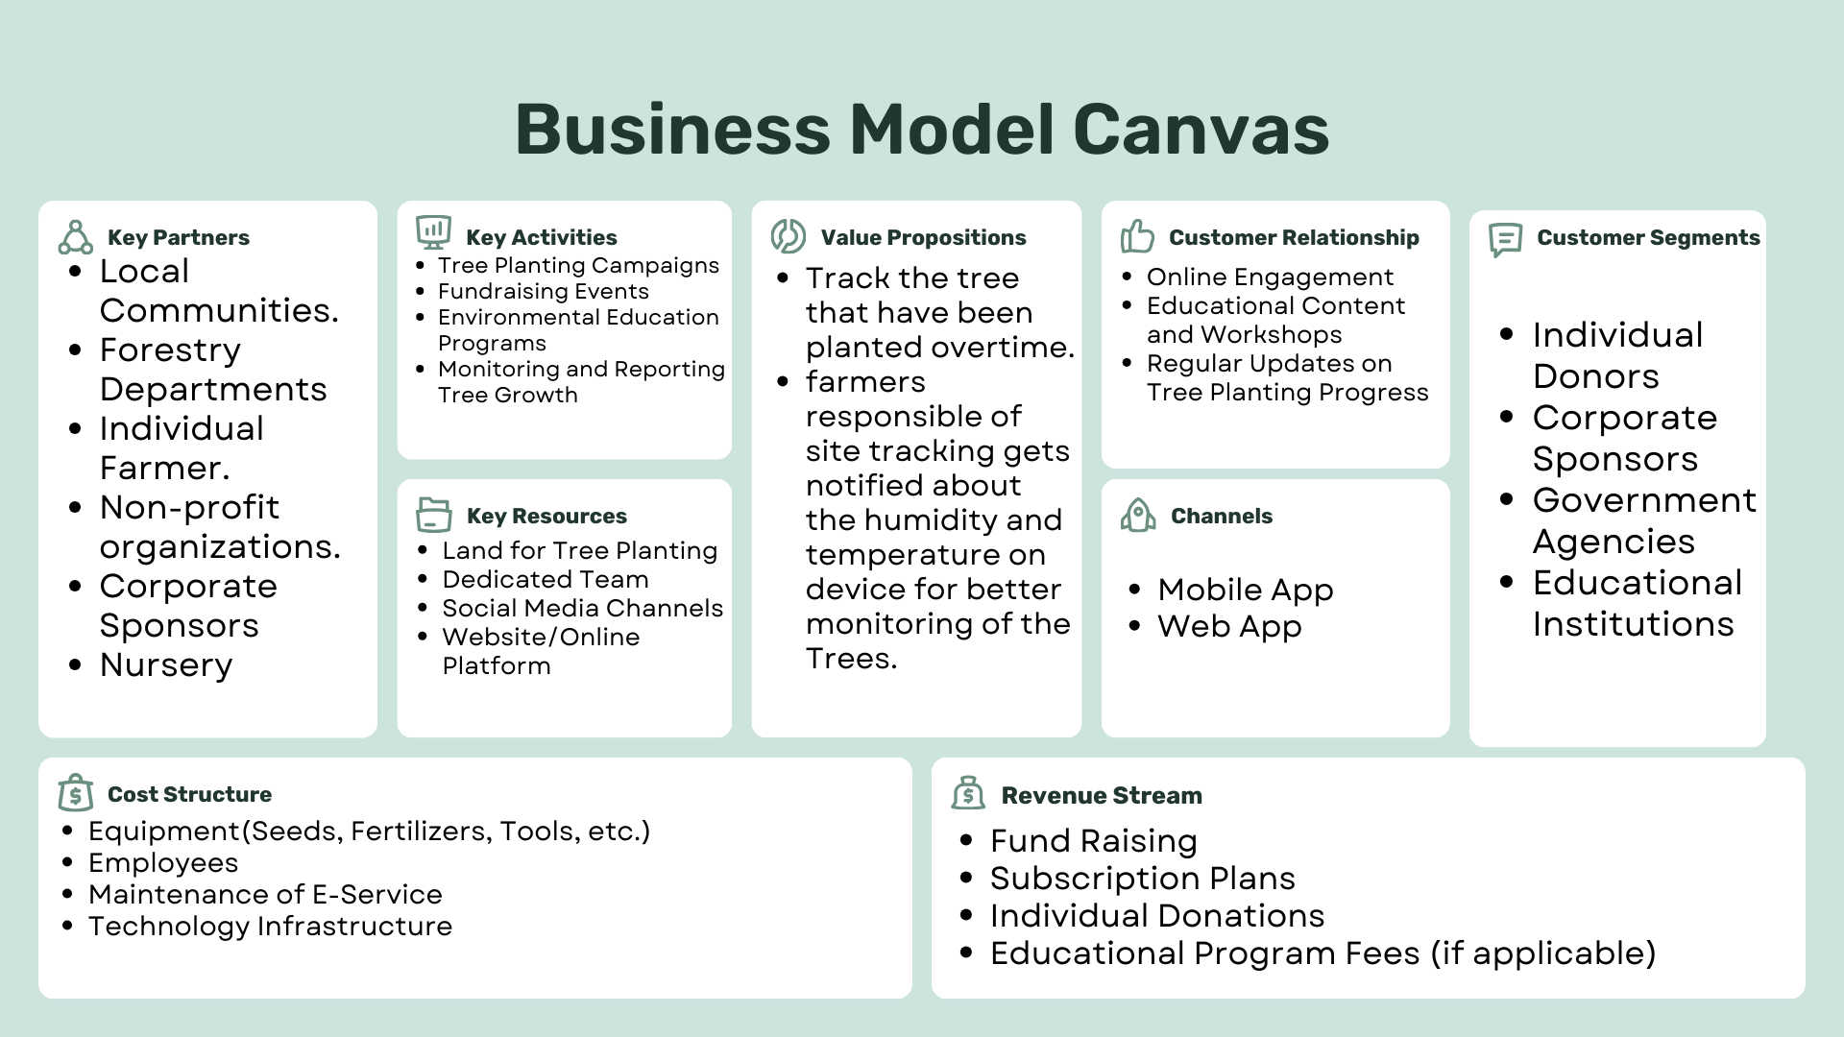

Slide 9
Market Strategy
Partnership with Local Government, Community and Corporate Companies
Educating People through audio, video and text contents
Subscription model
Annually Payment
Quarterly Payment
One Time Payment

Slide 10
Market Analysis
Forests cover approximately 44% of Nepal's land area, only 20% of the Terai forests remain today.
1.3 million hectares of cultivable land was left barren
Farmland has shrunk by 2.1 percent from 2000 to 2019 by KU Latest data
by All Nepal Peasants' Federation

Slide 11
How did we managed our Code?
Model View-Viewmodel
Clean Architecture in Django
Minimalistic and simple UI with reusable component

Slide 12
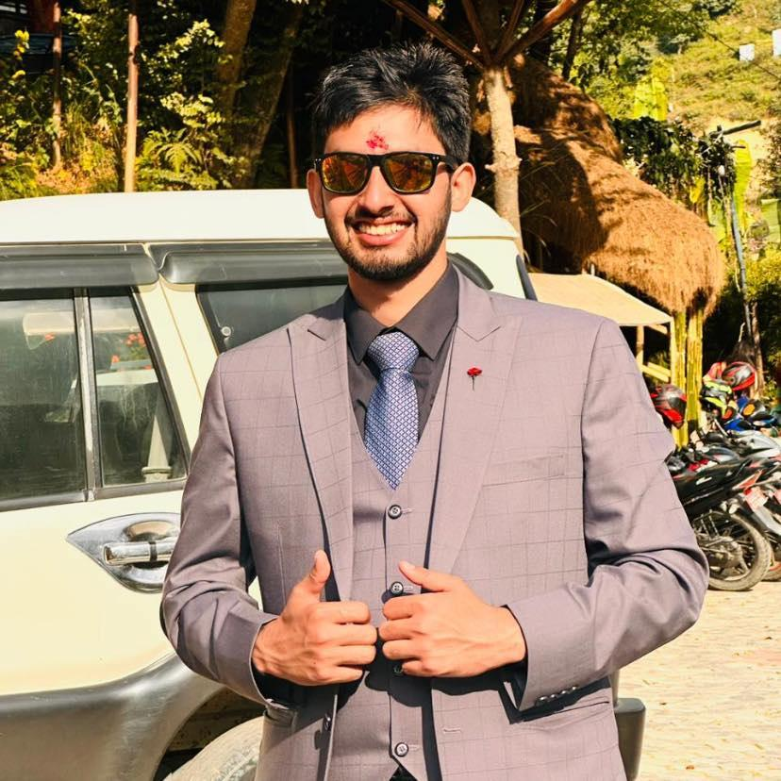
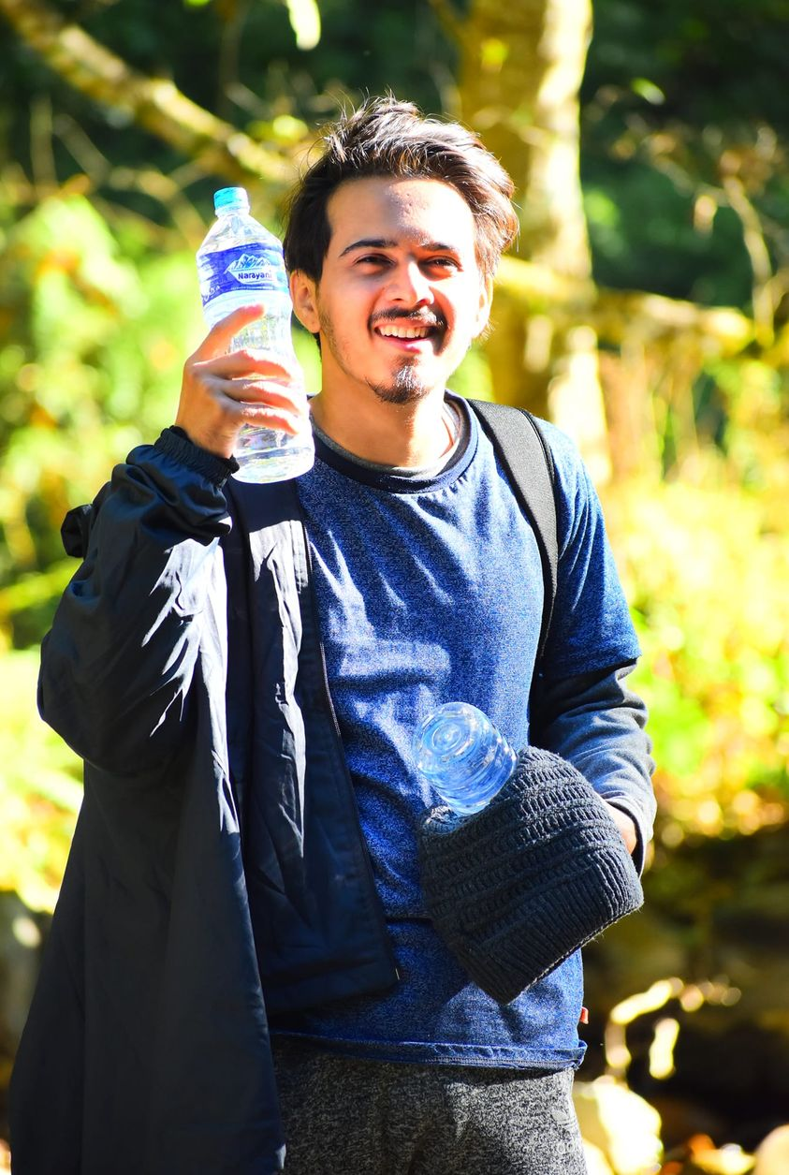
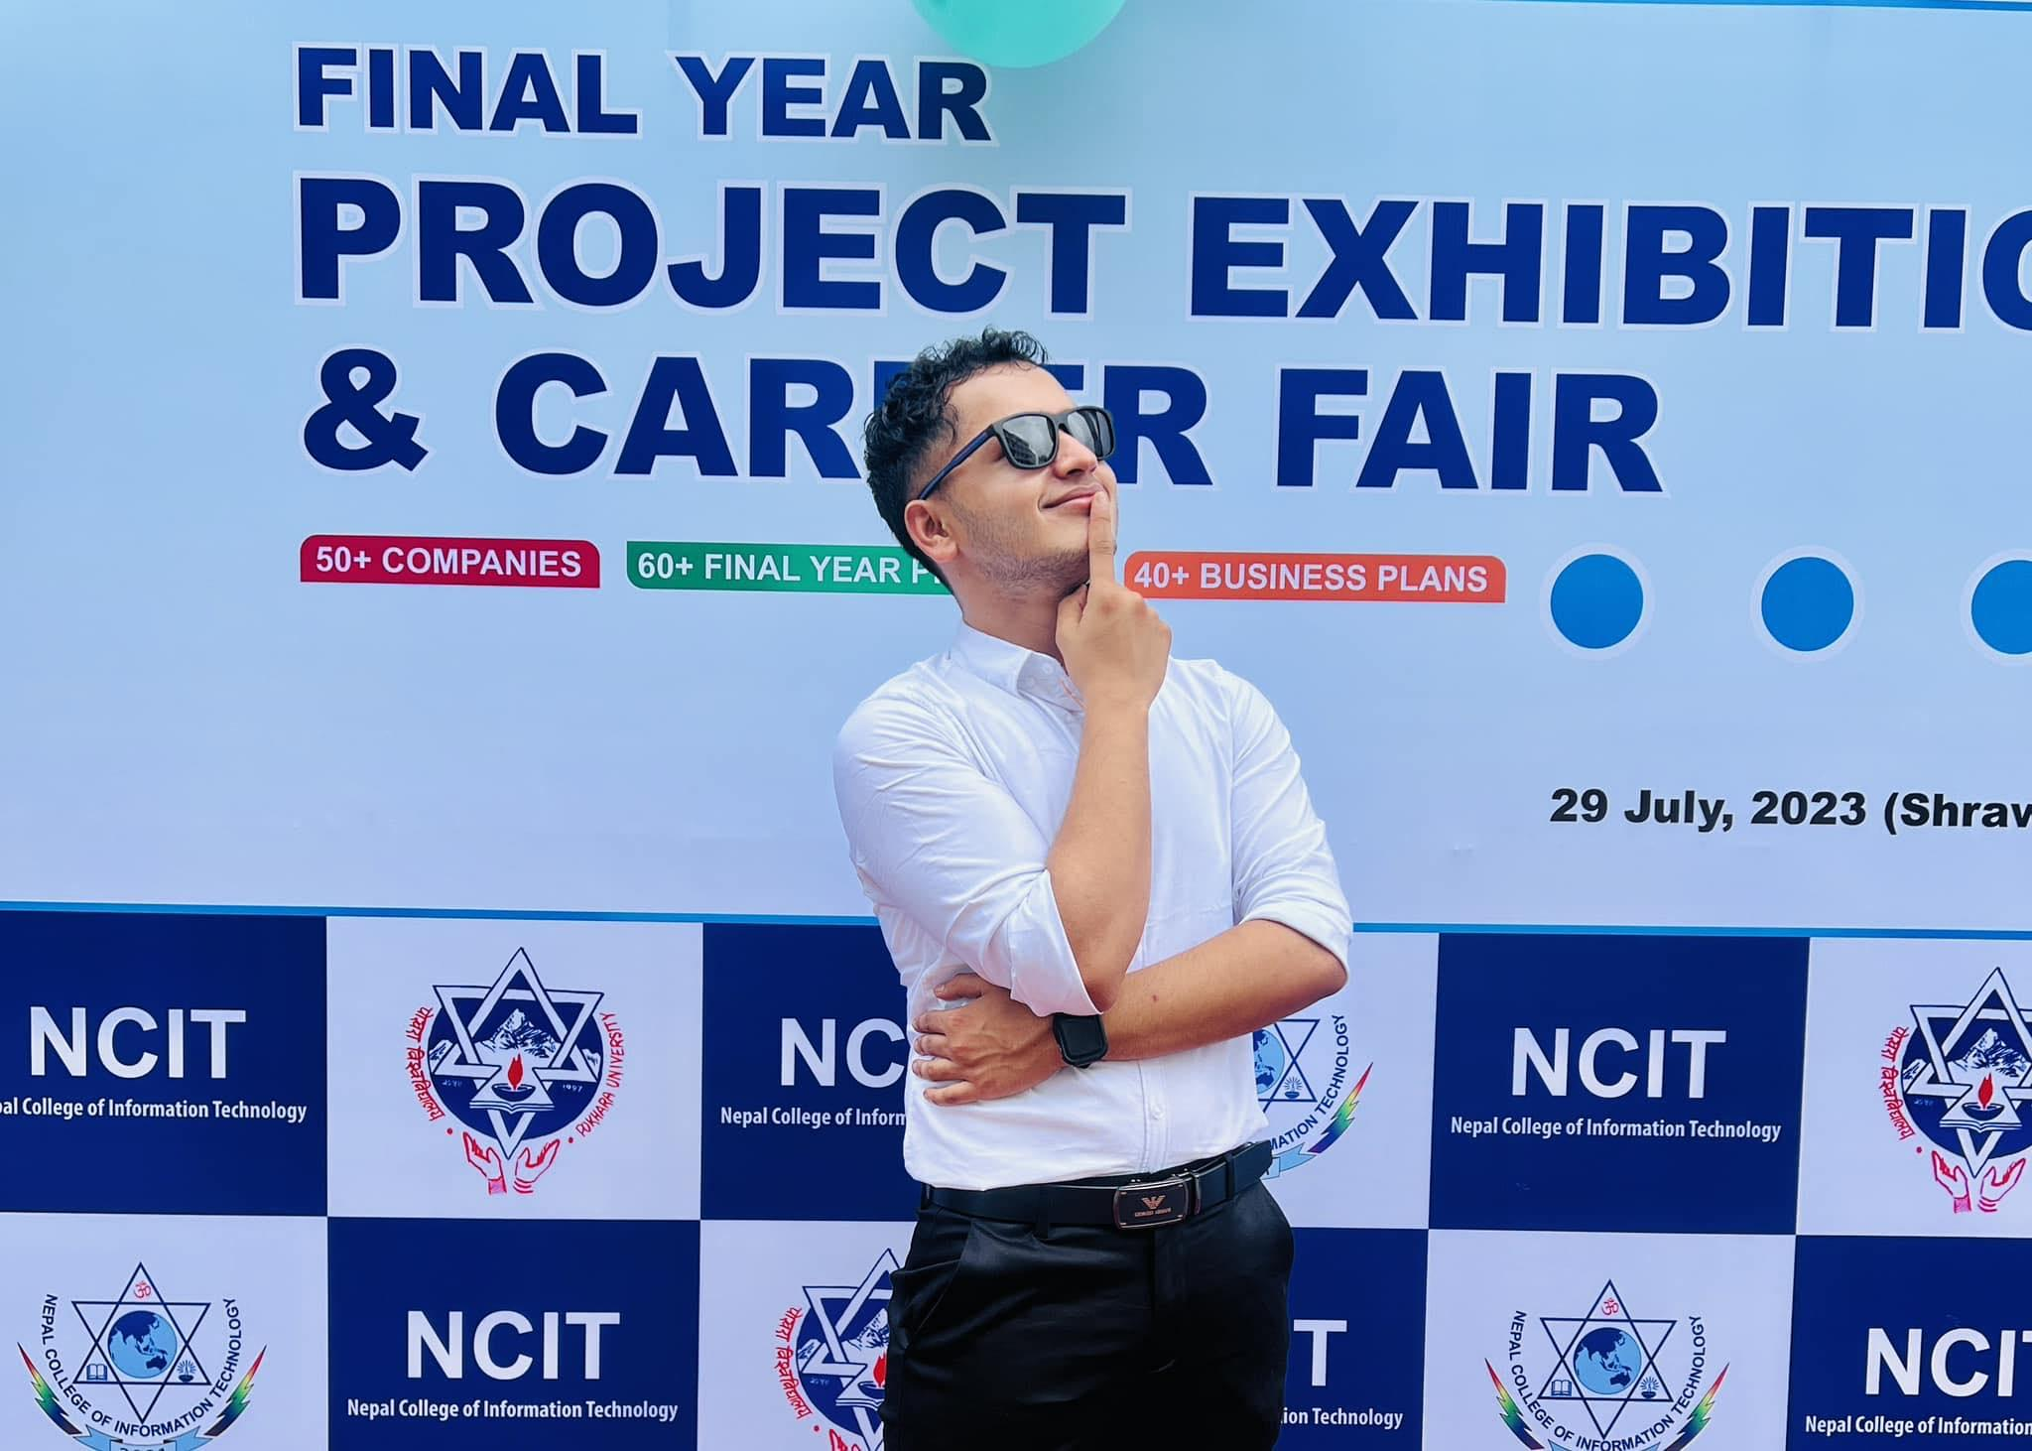
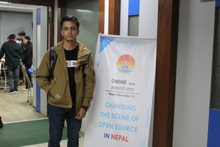
Our Team
Mr.Bibek Dhakal
UI/UX
Designer
Mr.Milan Kharel
FrontEnd Designer
Mr.Arjun Ghimire
BackEnd App Developer
Mr.Manish Poudel
IOT Developer

Slide 13

Future Plans
Making corporate Donation possible to fulfill their CSR goals.
Making Web and Mobile design more responsive
Adding More Features of IOT Devices

Slide 14

Thank you!
अहिले नगरे कहिले गर्ने हाम्ले नगरे कसले गर्ने

